Slide 1
‘The man who does not read has no advantage over the man who cannot read.’
Mark Twain
Notes:
Fabulous quote by Mark Twain – the author of ‘the adventures of Tom Sawyer’ ….
So its basically saying: somebody who does not take advantage of reading books (who can) is equal to an illiterate person.
There are so many benefits to reading – it is such an important life skill to be able to obtain knowledge and for confidence and so we must really encourage our children to read as much as possible.

Slide 2
Research
Learning to read is one of the most important gifts we can give to our children. Teaching every child to read well is vital, but it is only half of the story. For children to share all of the benefits that reading can bring, we've got to help them to grow into life-long readers. We have to teach everyone to read and do everything we can to encourage children to actually choose to read.
Studies have found that reading for pleasure is more important to a child’s educational achievement than their family’s wealth or social class and those children are more likely to achieve highly across all areas of the school curriculum.
If reading is a pleasure for them, children won’t see it as ‘work’, but as a way of accessing a wealth of information and opening door to other worlds.
We are all well aware of the link between reading and writing: good readers are most likely to be good writers. So the underlying message in the English curriculum - that promoting reading for pleasure is vital - is one that every teacher and parent should echo.

Slide 3
How do we create good readers?
Passionate/genuine enthusiasm
Effective questioning
Knowledge of books/authors
Time (well planned)
Modelling (seeing others read)
Lots of resources
Notes:
So we know its important – but how do we create them?
Today we will look at some of these things:
How to ask effective questioning, how to know which books are best etc
Resources wise, We have invested a lot of money into new books – library is full of recommended books and classrooms
Time is a big factor – we all lead busy lives but making the time in the evening or in the morning during breakfast is so important

Slide 4
Aims for today:
To give you, the parents, more information about how we teach reading in school
and
to help explain how you can support your children at home.

Slide 5
Where does reading fit into the curriculum?
Every lesson! More specifically:
Engagement part of sequence (emerging in genre, model texts, hot seating, drama, talk4writing etc)
Hourly reading sessions
Class readers/shared reading
Independent reading and library visits
Interventions for those children who need to ‘catch up’ (before and after school and afternoons)
At home
Notes:
In all lessons, children are expected to read in order to understand questions, information in history, instructions in science or DT etc etc - it is hugely important.
-reading sessions – I will talk to you more about what we do in these sessions later.
-Our class reader is a book we read together as a class and the children have a copy between two – it is of that year group standard which is good for those children who do not usually read age appropriate texts.
-After registration in afternoons, there is usually a period of silent reading time

Slide 6
How can you help at home?
Let your children see you reading – letters, internet, newspapers, leaflets, magazines (it does not just have to be books – especially reluctant readers – this is a good way to get them reading for pleasure.)
Discuss books with your children: Does the cover make you want to pick it up? Does the blurb make you want to read it? Is the print clear and well- spaced on the page? Are any pictures attractive? Try reading a page at random to get a feel for the style and see if the pitch is suitable. Model this behaviour to your children to help them know what to look for when choosing books that will suit them.
Go to the library together: Come to our library together after school – see me!
Notes:
1)Do your children see you reading for pleasure? Modelling enjoyment of a good read?

Slide 7
Read a page each (paired reading improves fluency and confidence)
Read to your child, even if they can read, as they benefit from being read to – providing an excellent model. Especially pace. (By year 6, 150 words per minute)
Read every night – make time! Must be a regular occurrence (around 20minutues)
Notes:
Also speeds up completing a book
2) Also modelling characterisation in voice, reading to punctuation – pace is vital: in the new curriculum, children are expected to read more in timed tests – use a lollipop stick to cover the words and unravel them as you read so speed their pace up! (Hacker text on table – first page is about 150 words) – time yourselves later!!
Sometimes children don’t want to read – it’s a chore. How can we make them have this love for reading? For some children, they must find a particular author that they love. For those reluctant readers, its engaging them: here are some tips and helpful websites..

Slide 8
Helpful websites
A fabulous website is http://www.lovereading4kids.co.uk/ They give book recommendations that are sorted by age group with enough of a blurb to help you make informed choices. There are many different categories: reluctant readers, children’s classics, books for boys, books reviewed by children and, my favourite, ‘If they like… They’ll love’ which is designed to help children discover new authors. E.g.
If they like Michael Morpurgo they’ll love Megan Rix and Nick Garlick
If they like David Walliams they’ll love William Sutcliffe
If they like Jacqueline Wilson they’ll love Anne Booth and Dawn McNiff
If they like Alex Rider they’ll love Urban Outlaws
If you register, you can read extracts from the books and the opening pages to help you identify whether a text will be a great read. Take a look at the awards section. The website is constantly updated and you can see the top 10 bestselling children’s books for each week.
Lets have a look….
Notes:
Sometimes children get stuck into reading a certain author and don’t change – but reading a rich variety of books is also important – these are some useful websites to help…

Slide 9
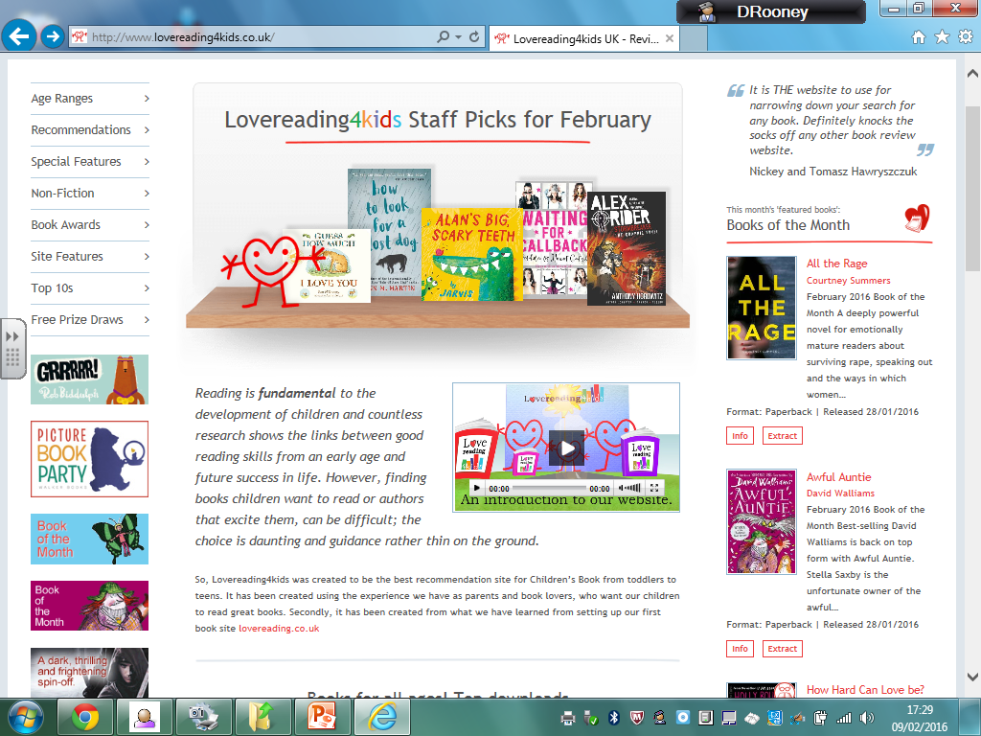

Slide 10
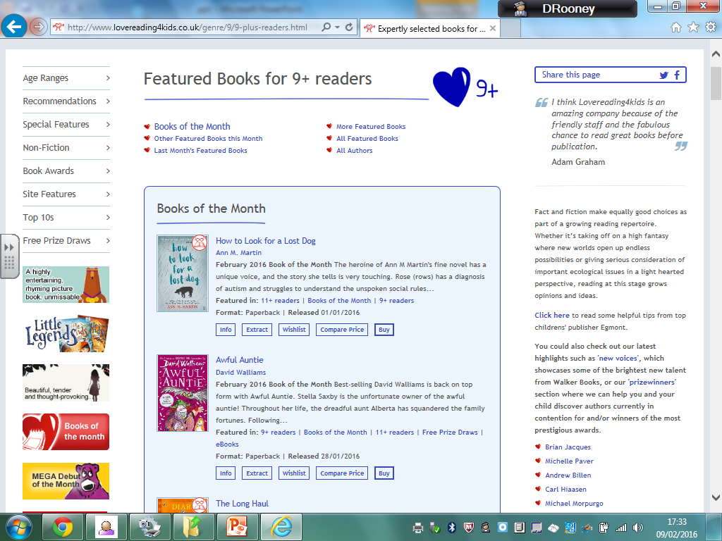

Slide 11
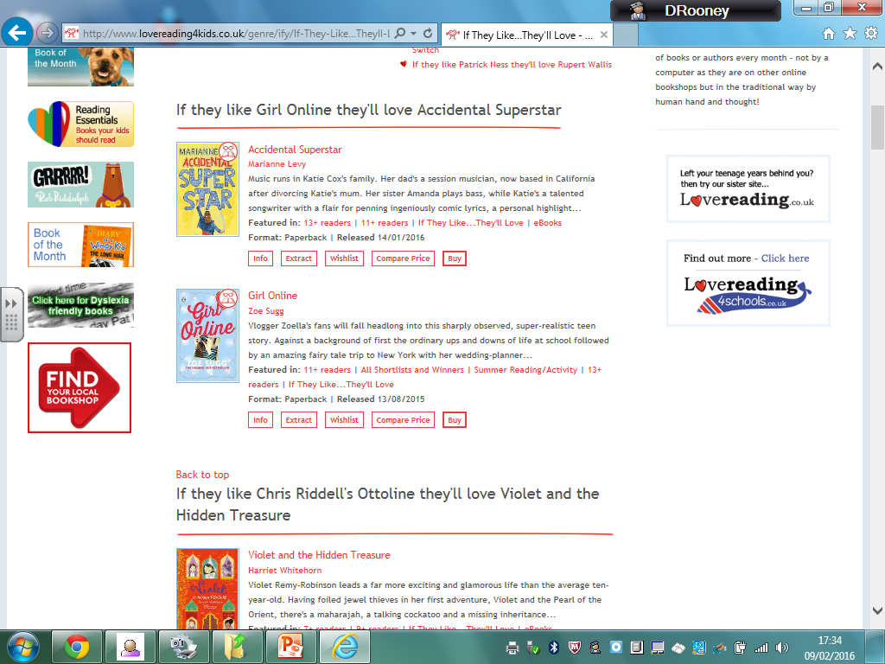

Slide 12
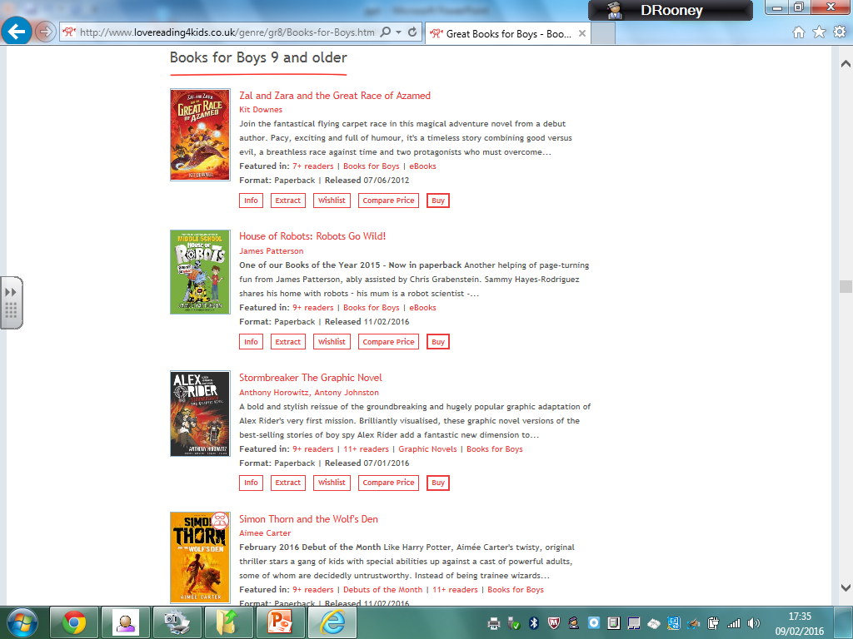

Slide 13
BookTrust’s stated aim is to inspire a love of reading; BookTrust’s Children’s books http://bit.ly/BookTrustChildren
Amongst the myriad book recommendations, again usefully sorted by age, genre and interest, there are also downloadable resources, videos and children can read books online, listen and read along and take part in quizzes and competitions.
Words for Life (http://bit.ly/WordsforLife) a website set up by the National Literacy Trust which is set out in age bands from birth to 11 years. As well as the book recommendations you would expect, there’s guidance to help parents recognise key milestones in children’s development as readers and fun ideas and activities for parents and children do together. There are also helpful videos to support with both decoding and comprehension. Parents can watch Michael Rosen’s top tips for reading bedtime stories.
www.oxfordowl.co.uk/reading (ebooks)
www.firstnews.co.uk
Notes:
Your pack includes two book lists (one from Hertfordshire and one shared with us from another school)

Slide 14
What is reading?
Some parents get confused about the term: reading!
Word reading (how well children read out loud - decoding)
Comprehension (understanding of what they have read)
Both are important!!
Notes:
This may be a stupid question but …. (even my mum with my sister doesn’t understand fully – she says ‘but she can read well’ yes but can she understand what she reads?) Word reading must come before comprehension. If they cant word read then it is difficult to comprehend.
Word reading is their accuracy of pronunciation and the speed they read the words. Here, we listen out for enthusiasm in characterisation and use of punctuation.
Comprehension is vital for junior school. Children who can not word read age appropriate texts have interventions to catch them up and as soon as they can word read, it becomes the main priority : their understanding of the text (see national curriculum statements in handouts)

Slide 15
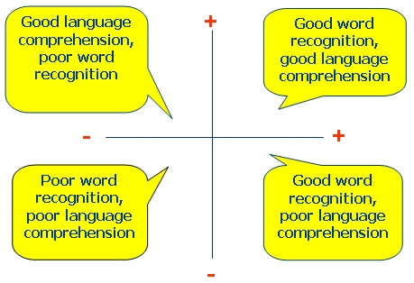
Notes:
Explain table: Can you identify where your children are?
(top left = if read to, top right = where we want all children to be, bottom right = struggling with understanding, bottom left = need to tackle word reading first)
If children are still on the left side somewhere or when reading a challenging text, struggle on tricky words, there are a few strategies:

Slide 16
Strategies for decoding:
-Don’t jump in when your child makes a mistake – let the child read to the end of the sentence then ask them if it made sense or to re-read it and see if they correct it themselves.
-Wait 4-5 seconds before telling them a word they are struggling with.
-Sound it out (obvious one!) start with first letter or letters: grapheme and phonemes and then say each letter(s) out loud. Blend the sounds together and say the word
e.g ch-i-p
Notes:
All strategies are in your hand outs but these are the important ones……
Easy thing to do is to jump in!! Don’t!!
You may notice other sounds in the middle of the word and sound letters out around it…

Slide 17
-Chunking or breaking the word up:
look for familiar ‘chunks’ in the word that they know
e.g. ‘cup-board’ or ‘sup-port-ing’ or it could be separating prefixes and sufffixes
e.g. il-legal or sprint-ed
-Make a connection: do they know a word that looks and sounds similar
e.g. make/take
Notes:
Board (oa sound) – may use more than one strategy per word.
There is a lot of help for this on the ‘words4life’ website – especially understanding and pronouncing the phonic sounds
Main part of today is looking at comprehension skills…

Slide 18
Comprehension
Comprehending is an eye and mind event. Print enters the eye; words take shape in the brain; they run through a schema and are given life by what a reader holds in his or her schema. Meaningful images form in the mind, which results in the reader understanding the meaning of the text.
So, children are not just expected to say and understand the words they see but respond to a text. This is by:
-finding and using details of information
-understanding what the text ‘suggests’ but does not directly say
-understanding why a text is organised in a particular way
-explaining why a writer chooses particular words to create an affect on you, the reader
-explaining what effect the writer has achieved with the text
-understanding what texts show when and where they were written
Notes:
So what is it?
The main question types will now be explained. All questions in comprehensions fit into one or more of these categories and during our weekly reading session, we focus on particular skills. I will go through some examples now and explain how you could help at home also.
Authors always include certain things on purpose and children must learn to naturally pick up on these things whilst reading to ‘read between the lines’ – very difficult to teach and depends on life experiences also. We teach children how to answer certain question types…
This is what we assess them on on for government data (sats) and their 11+

Slide 19
The question types the children will be exposed to will be the same from year 3 to 6, it is just text difficulty that changes (this includes length and complexity of text).
Therefore the knowledge and skills that pupils need in order to comprehend are the same.
Asking the right types of questions is so important when listening to your child read at home E.g. finding a specific answer, finding meanings of words, what will happen next? giving an opinion, evaluating – what they enjoyed and why? Etc.
Notes:
Reading domains are printed in your handout and time spend on them…

Slide 20
Retrieval
“what’s that you’re hiding there, Billy? Show me, show me at once.” She took Billy by the shoulder and swung him round to face her. Billy expected her to scream but she did not. Her mouth gaped in horror as she backed away from him, knocking over the kitchen stool behind her. “Get that thing out of here,” she whispered, “Get it out now. Do you understand me?”
“Yes, Aunty May,” said Billy. With the fox cradled against him, he walked to the front door and opened it. “Goodbye,” he said, and it was gone in an instant.
Did Aunty Mat scream?
What did she knock over?
What was Billy hiding?
What did he do at the end?
Notes:
This is the easiest question type and simply requires the children to ‘find’ the answer in the text. In years 3 it may be in one paragraph and in years 6 it may be in the whole text. This requires children to remember the order of events to know where to look for the information. They may be asked to summarise or give direct quotes from text
Question starters for parents to ask with books at home in handout.

Slide 21
Can you ask some questions about this?
The honey bee is an insect. It is bright yellow and orange. It is 12mm long and has six legs. The honey bee has three separate parts to its body and this insect lives in all parts of Australia. These bees collect nectar for honey. They dance on the honeycomb to show the other bees where the best flowers for honey are. Amazingly, honey bees may fly 20,000km to collect enough nectar for 500g of honey.
Notes:
Have a look at the examples of questions for year 3 and 4 and then years 5 and 6 : children will need to give evidence as they get older.

Slide 22
Inference
To form an opinion, hypothesis or a judgement that something is probably true because of other information that you already know. This uses your prior knowledge and ‘reading between the lines’
Notes:
Arguably the trickiest of them all – requiring good life experiences. Along with retrieval, this has the most weighting in marks
For example…. (next slide)

Slide 23
A man was standing in the doorway. He looked out and put up an umbrella.
Question: what was the weather like?
Answer based from the actions of the character - He put up his umbrella, therefore it was raining as the umbrella is used to prevent the rain getting the man wet. Or it could be sunny and the umbrella is used to shade the man and stop him from burning.
Near the beginning of a story we find out the main character’s wife and child died a few years ago. In the middle of the story at the main character’s home another character sits in a chair that is not normally used. The man shouts ‘ Nobody sits in that chair!’
Question: Why did he shout?
The reader could infer that the chair might have belonged to his wife which made him upset. This inference could lead the reader to think the action of the other character sitting in the chair has brought back painful memories for the main character. The man is shouting so he is cross.
Notes:
First question: retrieval = where was the man standing?
For children to infer, they have to be able to: connect, understand vocabulary, predict, question and visualise….
So.. When teaching, we must look at these key areas:

Slide 24
Vocabulary
Katrina looked her friend up and down several times and smiled,
‘what a beautiful dress, Annie’.
The sarcasm in her voice was obvious to everyone.
Notes:
Vocab is a strong indicator of reading success. Poor vocab leads to poor reading comprehension. They must understand what they read to be able to infer.
If the child doesn’t know what sarcasm is – wouldn’t be able to understand this and therefore wouldn’t be able to answer the question: Did Katrina like Annie’s dress?
When reading at home – you must really make sure all words are understood (even if you think they are obvious) – use dictionary

Slide 25
Connect
The story reminds them of something they have experienced
Their mind becomes flooded with memories
They are making sense of the text in terms of events and people in their own lives
They can make connections to pictures, plot, characters, and feelings from the story
Notes:
They will need to visualise a text to help with this…
When children connect, the: (bullet points)
e.g. if it was written that a man was walking down a street with his head down, feet dragging and shoulders slumped – question: How was he feeling? Have you done this before? When? (sad, tired etc!)

Slide 26
Predict
Stop at crucial moments of a text to predict what the next part might be about before reading it - makes readers pay more attention. Consider the reasons for their predictions, look for evidence in the text.
Read on and point out the explicit and implicit evidence that supports or confounds your predictions. Discuss!
Notes:
This does not mean guess!! This again links to prior experiences and connecting with events and actions
(explicit = obvious information, implicit = not directly obvious)

Slide 27
What will happen next and how do you know?
Daniel was playing Wii when his mum called into the
house and asked him to come outside to help her carry in
some groceries. He reluctantly put down the remote and
walked outside to help. Daniel grabbed two bags from the
car and began walking back to the house. Daniel's toe hit a
rock and he tripped. He felt the bags falling from his arms
and toward the ground just as he heard his mum yell back,
"Be careful with those bags Daniel, they have eggs in
them!"
Notes:
Can you connect to this? Not guessing, based on what you’ve read so far and your experiences in life…

Slide 28
Drama. To support the children’s understanding we might ask them to create a freeze frame.
They could either recreate the positions of the two people in the picture or they might recreate what happens just before/after. Once the freeze frame is in place, another child becomes the ‘thought bubble’. They say what they believe the character is thinking right that second.
Hot seating is also used: the teacher acts as one of the characters and the children have the opportunity to devise questions to ask them. Then the teacher models an answer based on what they know about their characters.
Notes:
When teaching inference, we use: (bullet points)
This is effective as it gets the children thinking as their characters actions and why they did certain things etc.
E.g. recently, in year 5, we have been looking at the highwayman (we were trying to infer characters thoughts and motives) and we got the children to come up with some questions that they would like to ask the characters e.g. to Tim: why did you listen in on their conversation? (we knew that he loved Bess but we could infer that he was jealous and didn’t like Bess being with some one else etc). This then helps them to generate ideas by orally rehearsing them first before writing them down on to paper (which they often find difficult)

Slide 29
Tell me about this picture
Notes:
This is a good way to teach inference because the children are not put off by words.

Slide 30
children are taught to justify their comments e.g. ‘I think …. because ….’.
Possible responses could range from:
‘They might be poor because the teapot is cracked and you would probably have bought another one if you had enough money’
to
‘She is trying to make him feel better because her hand is on top of his and this is how people show they care.’
Notes:
May also say that he is going away as there is a suitcase on the table etc.
The children's answers are rarely wrong when doing this so it is a good way to give them confidence (esp low ability)
Children must support answer and is a key reason why they don’t acgieve full marks when answering inference questions: they know the answer but haven’t explained how they know!

Slide 31
Activity
What can you infer from this picture? How do you know?
Notes:
See handout for question starters
Based on what you know:
-connect
-redict
-justify
Explain how if this was written in words (e.g. the girl rested her hand on her forehead, wore a dressing gown and had a thermometer in her mouth) the chidren wouldn’t give as good as a response than seeing the picture and this is why they must visualise to connect.

Slide 32
Pat walked home from school, trying to avoid the puddles.
'I'm glad it's Saturday tomorrow,' she thought. 'Though the weight of this bag reminds me how much homework I've got. I think I'll try and do it tonight so I can go shopping in the morning.’
How old might Pat be? (Infer from lots of homework and it sounds as if she's going shopping alone.)
What might be in the bag? (Books as she comments on the weight and homework.)
How far is it from the school to Pat's house? (Infer it can't be miles and miles as she can walk with a heavy bag.)
What homework rules might Pat's parents have? (Infer she has to do homework before going out shopping etc.)
What was the weather like earlier in the day?(Infer it has been raining as there are puddles. We don't know if it still is.)

Slide 33
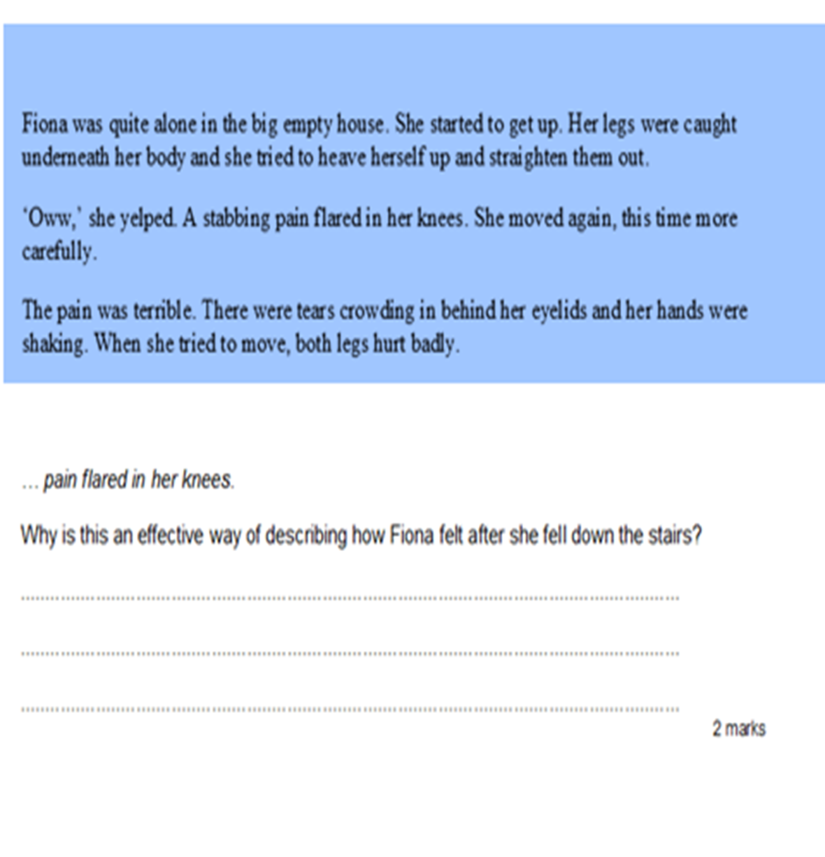
Language for effect
This is about why the author has chosen certain words: what the impact is on the reader e.g.

Slide 36
expensive
beautiful
envied
rare
bling
diamonds
valuable
Jewellery – rings, necklace
sparkly
admired
precious

Slide 37
- Award 1 mark for answers which refer only to the shining / glistening / sparkling quality of diamonds.
-Award 2 marks for answers which refer to other aspects of diamonds, such as their value or use in jewellery
E.g.
-shiny, glittering and valuable;
-the webs are like diamond necklaces because the spider’s silk is like the thread on which the diamonds of dewdrops are laced;
-the web is as precious to the spider as a diamond is to us and it is also beautiful the way it shines in the sun;
-beautiful chains of crystals, transparent and sparkling.

Slide 38
Activity:
… it took nearly a year for news about the discovery of gold to leak out … What does the word leak suggest about the way the news spread? Create a word association for this to answer the question…
Notes:
What do you know about the word leak? When have you seen things leak? etc

Slide 39
Writers purpose
For these questions, children have to work out what the overall purpose of a text is e.g. is it written to:
inform, persuade, create suspense, amuse, advise, describe? Etc

Slide 40
Example:
I love the way the Italians park. You turn any street corner in Rome and it looks as if you’ve just missed a parking competition for blind people. Cars are pointed in every direction, half on the pavements and half off, facing in, facing sideways, blocking garages and side streets and phone boxes, fitted into spaces so tight that the only possible way out would be through the sun roof!
What was the writer trying to do in this text?
Advise? Entertain? Give information? Give an opinion? What clues are there to tell you this?
Notes:
More examples of this in your hand out

Slide 41
Structure and organisation
Firstly, know, understand and be able to identify the presentational devices used
Secondly, explain why these devices are used and the effect they have in context. (this is the hard bit!)

Slide 42
Tables, diagrams and boxed texts
Pictures including arrows to show movement
Font: bold, italics, capitals
Quotations/ inverted commas
Specific punctuation e.g. bullet points, ellipsis
Headings/subheadings
Paragraph lengths and sentence lengths/ and order
Plus more!

Slide 43
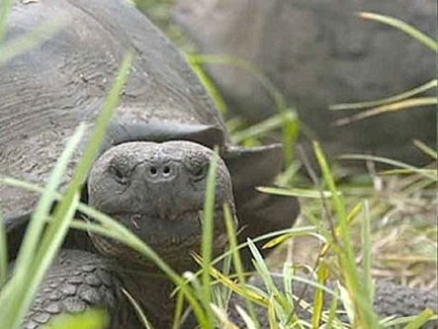
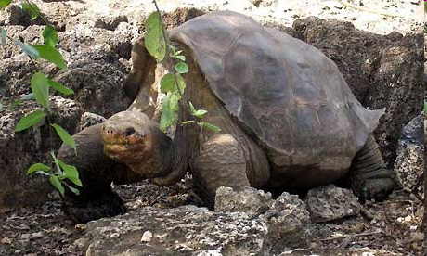
GIANT Tortoise Facts
Are the largest terrestrial reptiles on earth.
Weigh up to 300kg
May live for more than 150 years
Colonized Galapagos from South America some 2-3 million years ago
Once occurred on 10 islands. Today, wild tortoises are restricted to just 6 islands
May have comprised 15 sub-species, while today only 11 are recognized.
Lonesome George' at the breeding centre Fausto Llerena on the Galapagos' Santa Cruz Island.
Photograph: AFP/Getty Images
Lonesome George Key Facts Species: Geochelone abingdoni Common name: Pinta giant tortoise, “Lonesome George” Size: 102cm across shell, 88kg in weight Habitat: Charles Darwin Research Station corral Diet: herbivore Range: None present on Pinta, “Lonesome George” resides at Charles Darwin Research Station Status: Pinta species is nearing Extinction Threatened by: introduced species, habitat destruction, historical predation by humans
Further Details
There is a reward of $10,000 for the discovery of a Pinta female
There are other giant tortoises which are located on other islands of the Galapagos Islands.
Notes:
What questions could you ask for this?? E.g. why is GIANT in capitals?
Explore answers…
(bold because
Bullet points
Subheadings and boxes
Picture and caption etc)
Its tough because the reason for one text being in bold is completely different in another text (not just to stand out!) and so the children have really got to look in context….
e.g.

Slide 44
Notes:
Bold – unfamilar words that need to be explained

Slide 45
Notes:
Acting as a sub heading – places and gives information about that place. We would know which box to go to if finding out about that place
More examples in handout (could be use of arrows to sequence or help reader know where to look next, tables, quotations to make people believe facts or to persuade people to go etc)

Slide 46
Children must interact with texts as active readers
‘unpicking the authorial techniques’ is important. To Identify how they respond to a text will certainly give them some idea beyond the technical aspects as to what they would like the reader to feel and respond.
Once these have been identified, the authorial ‘tricks of the trade’ can be plundered and attached firmly to our children’s toolkits. On their journey through the primary years, this toolkit will grow, and their understanding of how to select the right tool for the right purpose will be continually refined; they will see grammar as a way of refining and controlling their writing.

Slide 47
To sum up…
Listen to your children read – make the time.
Read to your children – no matter their age!
Ask effective questions: comprehension skills and grammar.
Discuss books.
I hope this has been informative and given you some of the necessary skills to enable you to help your children at home ☺

