Slide 1
Aims for today:
To give you, the parents, a better understanding of how we teach English within school to meet the New Curriculum expectations.
To give you some resources to help your child at home.

Slide 2
What is English?
Writing
Reading
Grammar
Speaking and listening
Handwriting
Spelling
English lessons take place daily and usually in the mornings when the children are most alert!

Slide 3
English is so important because:
Learning to read fluently for understanding, to write confidently and to express oneself well orally are essential life skills that underpin all other learning.

Slide 4
Aims: For children to:
-To speak clearly and audibly in ways which take account of their listeners
-To listen with concentration in order to be able to identify the main points of what they have heard
-To develop children’s ability to reflect, value and evaluate their own and others contributions
-To develop confident, independent readers
-To encourage children to become enthusiastic and reflective readers through contact with challenging and lengthy texts
-To help children enjoy writing and recognise its value
-To enable children to write with accuracy with regards to spelling, punctuation and grammar
-To study language usage and models of good writing to develop their own skills
-To write for a variety of audiences and purposes using a range of genres
-To have an interest in words and their meanings to grow a full vocabulary
-To embed children's ability to use planning, drafting, revising and editing to improve their work
-To write neatly, consistently and legibly to produce work which instils a sense of pride
For every child to experience success from the earliest possible stage

Slide 5
Vision
To ensure that every single child who leaves their primary education with us is equipped with a good standard of English skills to enable them the platform/opportunity to continue to fulfil their potential in Secondary School.

Slide 6
Genres
We teach the skills of literacy through genres
We hope to show progression through year groups and allow the children to write for a variety or purposes, audiences and styles and so they are exposed to a plethora of text types throughout their time in key stage 2.
Fiction (narratives: mystery, other cultures etc and poems)
Non-fiction (persuasive, balanced, recount, information text etc)
See English spine (page 5) to see your child's year group genres
See recommended book list for ideas (page 52)

Slide 7
How do we make good writers?
Knowledge of subject writing about
Understanding of grammar/punctuation
Edits (teacher, self and peer) and self reviews
Model texts/books/authors to aspire to and learn from
Shared writing/clear modelling
Etc. etc.

Slide 8
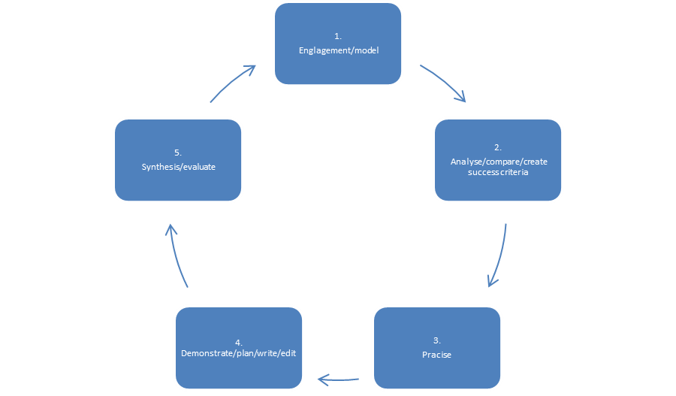
Teaching Sequence
For every unit within the genre we follow a set cycle to teach children the skills they need to be good writers:

Slide 9
Engagement
This is where the children immerse in the genre or the particular text type and gain an interest/better understanding of it.
Model text:
This is the most important resource. We can’t plan any unit of work without the core text. We, as teachers, must make sure that this has all the skills in which we are going to be teaching and therefore they are written by us. This text, the children will learn from and try to emulate.

Slide 10
Engagement: ideas/activities to explore the text/model
-hot seating/drama
-retelling a scene/summarising
-discussing likes/dislikes
-making connections -how certain aspects relate to the children’s lives
-talk for writing (learning structures)
-writing own questions to the characters
-note-taking
-comparing it to other previously read similar styles/books/authors
-find out what the children already know
-etc etc!

Slide 11
Analyse
We now want to understand why this text is so good and how we can make ours as good. So we have lots of discussions and is very much teacher led, asking the children to look for certain things and discuss its impact.
Highlight, annotate, underline, create keys
We then create a success criteria

Slide 12
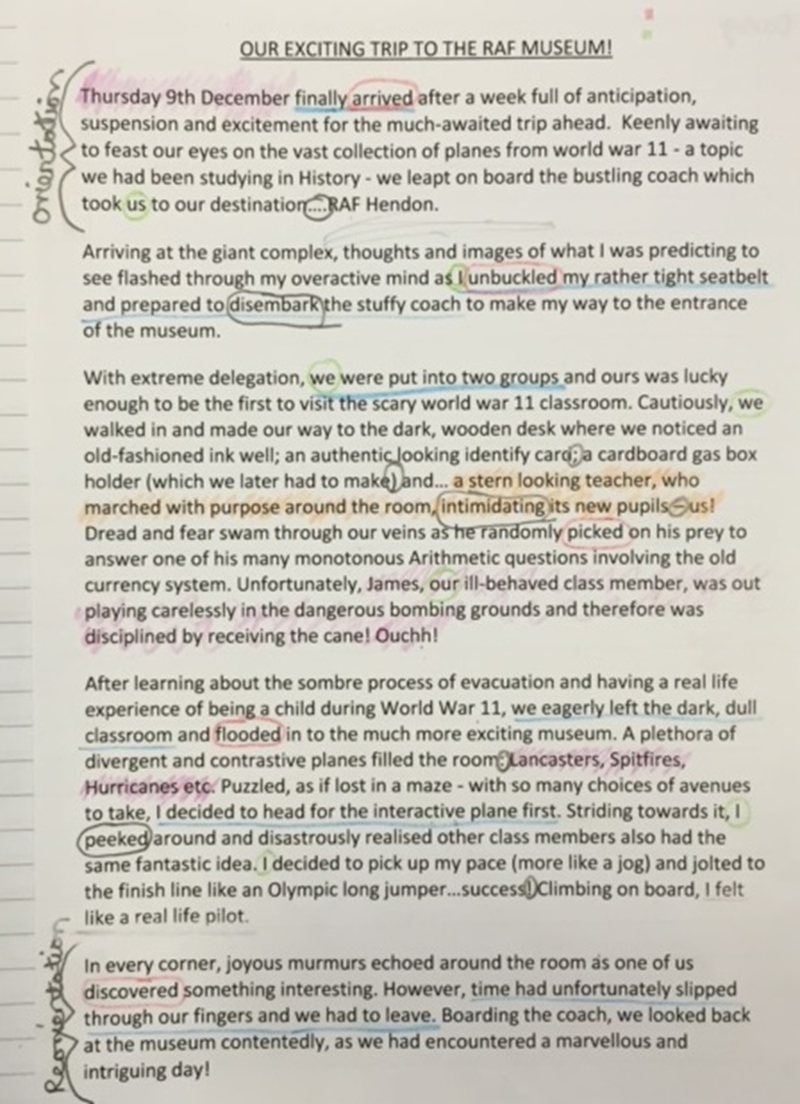
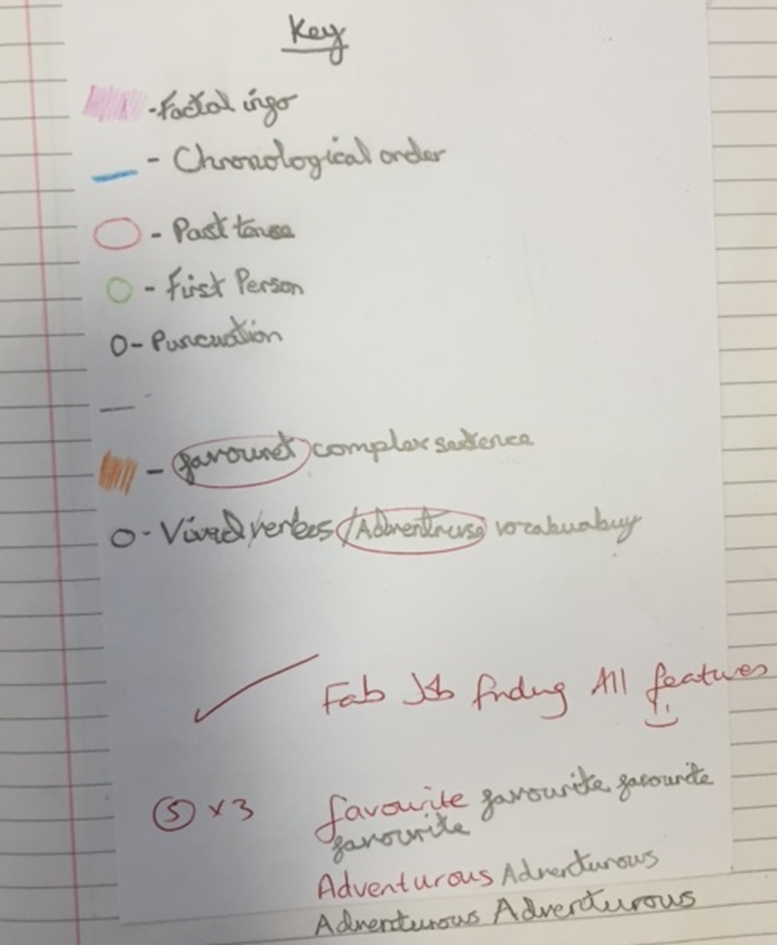
Example

Slide 13
Success criteria
Have you remembered to:
Write in first person consistently to show that it is about you and your experience?
Write in past tense throughout by checking the verbs agree to allow the reader to make sense of your writing and show the event has happened?
Used linking clauses and phrases (and occasionally time prepositions/adverbs) to show movement and chronological order?
Used complex / multi clause sentences throughout to add detail? (subordinate clauses, relative clauses and co-ordinating conkucnitons)
Included factual information to keep the reader informed as well as entertaining them by giving personal opinions and interesting events?
Used vivid verbs, adverbs and expanded noun phrases to enhance the reader’s imagination?
Used your thesaurus to find and use interesting and adventurous word choices?
Used a range of punctuation choices to allow writing to flow and for pauses, extra information etc?
Your opening to include the orientation features and does your conclusion have a re-orientation?
Organised your information into appropriate paragraphs to allow your reader to follow the event clearly?

Slide 15
Practice
This is now where we practise all the features from the success criteria that we picked out from the model.
This includes:
- Grammar (mainly)
- Structure/organisation
- Genre techniques.

Slide 16
The dog barked.
Lets add an adjective to describe the dog. (This always comes before the noun)
E.g. The angry dog barked.
Your turn!
2) Now add an adverb to describe how the dog barked. (Lets put this after the verb)
E.g. The angry dog barked noisily.
Your turn!

Slide 17
The dog barked.
3) We will now give some more information about the dog (This is called an embedded clause. We can use the words: which, who, that, with)
E.g. The angry dog, that was abandoned, barked nosily.
Your turn!

Slide 18
The dog barked.
4) Now we will give some information about where it happened or when it happened. (This is called a prepositional phrase. We can use the words: during, after, behind, next to, in, outside, under etc)
e.g. The angry dog, that was abandoned, barked noisily in the park.
e.g. In the park, the angry dog, that was abandoned, barked noisily.
Your turn!

Slide 19
Lots more you can do: E.g.
Adding a subordinating conjunction to add another clause:
Since it was cold, the angry dog – that was abandoned – barked noisily in the park

Slide 20
Writing and editing
This stage is really important. This is where the teacher demonstrates how to produce a similar version to the model. (A very good version)
We are basically showing the children how to be a writer and so verbalising all of our thoughts with them whilst we are writing and explain why we are writing certain things – demonstrating what writers think like.
We stop and ask for the children's help throughout – children use mini whiteboards to write in full sentences and share.
Teachers take children's sentences and ideas but develop and improve them
E.g. child: ‘protecting the wardrobe like a mouse trap
teacher: ‘is this giving the right idea? Who protects people/things?
child: ‘protecting the wardrobe like a loyal guard’
teacher: ‘good’

Slide 21
Demonstrating
Only one paragraph is ever shared written at a time.
The teacher, with the help of the children, looks at the plan and success criteria to ensure everything is included.
The children are then sent away to write their own paragraph or section.
Once complete, whole class returns to look at the shared paragraph.
We then improve this one together.
With the skills learnt, the children then go and improve their paragraph.
This continues for every paragraph until text is complete

Slide 22
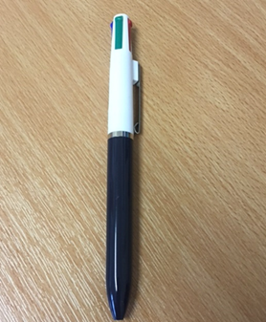

Editing
Big emphasis of editing in new curriculum.
Editing Success Criteria is on page 28.
We use this to teach the children become editors and improve their work.
This is modelled in the demonstrating stage
Each child has a coloured pen for the different sections.
It is differentiated into upper and lower school.
Coloured pens: blue (sentence), red (word), green (spelling + punctuation), black (general)

Slide 23
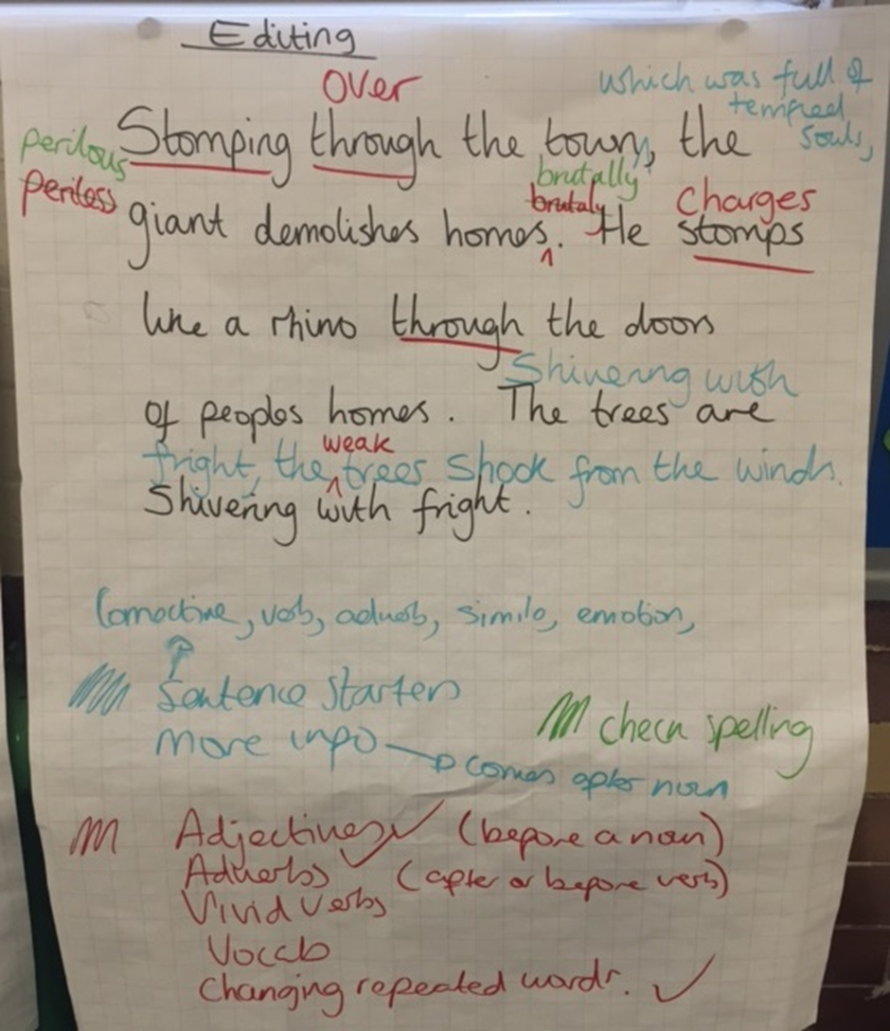
Example of editing

Slide 24
Miss Rooney strolled into the peacefull classroom to get ready for the busy day ahead. Looking in her cupboard, she realised the blitz day money had misterylessly vanished! Miss Rooney went straight to Mrs Henley to explain the discovery.
Underline any words you think may be incorrect – go and check in a dictionary.
Can we add an adjective before the noun ‘cupboard’?
Can we use a sentence starter before ‘Miss Rooney’?
Can we add an adverb after looking?
Can we improve the verb ‘went’ to make it more vivid?
Can we add an embedded clause after ‘Mrs Henley’?

Slide 25
After a strong cup of coffee, Miss Rooney strolled into her peaceful classroom to get ready for the busy day ahead. Looking carefully in her antique cupboard, she realised the blitz day money had mysteriously vanished! Miss Rooney sprinted straight to Mrs Henley, the trusted head teacher, to explain the discovery.

Slide 26
Synthesising/evaluating
We want to make sure that our final version is as good as the model text. So here, we compare ours and Self/peer assess against success criteria created.

